Slide 1

Mini Project Title: IBM-AIML
Team Details:
N. Vaishnavi (22101A010522)
K. Varshitha (22101A010480)
P. Deva Dhanush (22101A010321)

Slide 2
AGENDA-REVIEW 1 (12.02.2024)
Abstract
Introduction
Problem Statement
Objectives
Literature Survey
Limitations of Existing System
Workflow of the Proposed System
References

Slide 3
ABSTRACT
Earthquake prediction remains an essential task in disaster manipulation, necessitating current techniques to mitigate its devastating consequences. This project addresses this assignment via the software of system mastering techniques for earthquake prediction. The purpose is to expand a predictive model capable of forecasting earthquake occurrences with prolonged accuracy and reliability. Leveraging ancient seismic statistics and numerous geospatial functions, inclusive of fault lines, geological systems, and seismic pastime styles, our method employs a mixture of supervised and unsupervised device reading algorithms.
Supervised algorithms with Random Forest and Support Vector Machines are applied for class obligations, while unsupervised strategies like clustering resources in figuring out underlying patterns and anomalies in seismic statistics. By integrating the methodologies, our assignment objectives are to contribute to the development of earthquake prediction methodologies, thereby improving early warning structures and facilitating proactive disaster preparedness and response techniques.

Slide 4
INTRODUCTION
Earthquakes threaten human lifestyles, infrastructure, and societal stability, making correct predictions and early warning structures essential for disaster preparedness and mitigation efforts. Despite advancements in seismic tracking technology, the capacity to predict earthquakes with precision remains an outstanding undertaking. In response to this task, this challenge makes a specialty of leveraging machine studying strategies to improve earthquake prediction accuracy. We aim to increase a predictive version of forecasting earthquake occurrences with improved reliability by harnessing historical seismic facts and geospatial features. This introduction outlines the inducement inside the lower back of the task, highlighting the significance of revolutionary strategies in disaster control and the ability effect of the device to gain knowledge of methodologies for improving early warning structures and proactive catastrophe response techniques.

Slide 5
PROBLEM STATEMENT
26. Natural Disaster Prediction
Use sensor data and historical patterns to predict natural disasters like earthquakes, floods, enabling early warning systems and disaster preparedness

Slide 6
OBJECTIVES
Earthquake prediction remains a critical assignment in catastrophe management, necessitating innovative approaches to mitigate its devastating outcomes. This project goals to address this venture thru the software of gadget getting to know techniques for earthquake prediction, with the following precise objectives:
Develop a predictive version leveraging historical seismic facts and geospatial capabilities.
Improve the accuracy and reliability of earthquake forecasts the use of system mastering algorithms.
Implement supervised studying algorithms including Random Forest and Support Vector Machines for classification tasks.
Utilize unsupervised learning strategies like clustering to identify underlying styles and anomalies in seismic facts.
Contribute to the advancement of earthquake prediction methodologies to decorate early caution systems and proactive disaster preparedness and response techniques.

Slide 7
LITERATURE SURVEY
 | Paper Title | Journal/ Conference details | Methods Proposed | Datasets Used | Limitations
1. | A CNN-BiLSTM Model with Attention Mechanism for Earthquake Prediction | arXiv:2112.13444v1 [cs.LG], 26 Dec 2021 | Hybrid CNN-BiLSTM model with an attention mechanism for earthquake magnitude and occurrence prediction. | Earthquake catalog data from mainland China. | The model may not generalize to other regions without retraining and the unpredictability of earthquakes could affect the accuracy.

Slide 8
LITERATURE SURVEY
 | Paper Title | Journal/ Conference details | Methods Proposed | Datasets Used | Limitations
2. | Host-to-target region testing of machine learning models for seismic damage prediction in buildings | Natural Hazards, 2023 | Extreme Gradient Boosting (XGBC) with oversampling for seismic damage pre↓ on in buildings. | Post- seismic surveys from earthquakes in Nepal, Haiti, Serbia, and Italy. | Reliance on simplified building features could overlook other critical variables influencing damage
3. | Seismic Attribute Extraction and Application Bases on the Gabor Wavelet Transform | IEEE Access, January 2024 | A method based on the Gabor wavelet transform and linear dimensionality reduction for seismic attribute extraction | Field data to Italy. validate extracted seismic attributes for SVM, RF, XGBoost models, and deep residual shrinkage network. | Challenges include the complexity of seismic data and the potential for overfitting to specific geologies.

Slide 9
LITERATURE SURVEY
 | Paper Title | Journal/ Conference details | Methods Proposed | Datasets Used | Limitations
4. | Spatiotemporally explicit earthquake prediction using deep neural network | Soil Dynamics and Earthquake Engineering, 2021 | A deep neural network approach for spatiotemporal earthquake prediction, emphasizing the role of spatial parameters | Earthquake data from Iran provided by USGS and IIEES, covering 1973 to 2019. | The complexity of earthquake prediction and the model's potential overfitting to the data used.

Slide 10
LITERATURE SURVEY
 | Paper Title | Journal/ Conference details | Methods Proposed | Datasets Used | Limitations
5. | Spatio-Temporal Analysis of Hybrid CNN-GRU Model for Prediction of Earthquake for Disaster Manangement | International Journal of Intelligent Systems and Applications in Engineering | The paper presents a novel hybrid records. CNN-GRU model for earthquake prediction spatio- temporal analysis. It combines CNN's spatial feature extraction with GRU'S temporal pattern recognition, aiming for comprehensive with seismic event erstanding. | Seismic data enriched with geographical parameters. Specific datasets not mentioned, likely includes global seismic activity records. | The complex of seismic da and the unpredictabl nature of earthquakes present challenges in model accuracy anc generalizabil Further validation in diverse geological settings is necessary.

Slide 11
LITERATURE SURVEY
 | Paper Title | Journal/ Conference details | Methods Proposed | Datasets Used | Limitations
6. | A Particle Swarm Optimization-Backpropagation (PSO-BP)Model for the Prediction of Earthquake in Japan | Emerging Research in Computing, Information, Communication and Applications | The paper proposes a PSO- BP model for earthquake prediction in Japan, utilizing a combination of particle swarm optimization to optimize input parameters of a backpropagation neural network | Data from the Japan seismic catalogue provided by USGS, including parameters like latitude, longitude, magnitude, and depth of earthquakes. | Limitations are not specified but could include the model's dependence on the quality and completeness of the seismic data, as well as its potential limitation to the geographic area of Japan.

Slide 12
LITERATURE SURVEY
 | Paper Title | Journal/ Conference details | Methods Proposed | Datasets Used | Limitations
7. | DLEP: A Deep Learning Model for Earthquake Prediction | Authorized licensed use limited to: Auckland University of Technology. Downloaded on October 04, 2020, at 12:26:25 UTC from IEEE Xplore. Restrictions apply. Proposed Used Limitations Eight datasets from different regions including Sichuan, Xinjiang, Qinghai- Tibet, etc. | proposes the DLEP model which uses a convolutional neural network (CNN) to extract implicit features and attention-based strategy to fuse explicit and implicit features for earthquake prediction. It also introduces a dynamic loss function to address the category imbalance in seis! lata. | Eight datasets from different regions including Sichuan, Xinjiang, Qinghai- Tibet, etc | The limitations include the potential for category imbalance in seismic data and the challenge of generalizing the model to different seismic zones. The interpretability of implicit features extracted by deep learning methods can be weak.

Slide 13
LIMITATIONS OF EXISTING SYSTEM
Data Handling and Quality: The current systems might not be able to handle rapidly changing large, noisy datasets that are convoluted, decreasing the prediction accuracies due to poor data quality and insufficient noise reduction procedures
Feature Extraction and Selection: Classic models usually lack complex feature extraction techniques thus, do not capture key predictive signals within the seismic data.
Temporal Dynamics: Most of the systems do not capture the complicated time-related patterns in seismic data which are crucial in determining the timing and probability of events.
Overfitting: Overfitting is one of the most common issues that does hurt. When the model performs strongly on training data but poorly in real-world usage, overfitting often occurs as a result of inadequate regularization or heterogeneous data.
Imbalanced Data: The scarcity of earthquake events creates models that predict non-events which the existing systems do not have strategies to combat this bias.

Slide 14
LIMITATIONS OF EXISTING SYSTEM
Generalization Across Regions: Models trained on data from particular regions fail to generalize well when faced with the different geological or socio-economic conditions.
Computational Efficiency: There are systems with computational inefficiencies that limit the real-time data processing.
Integration of Multiple Data Sources: The lack of data integration across the different sources hinders reliable prediction with the present models.
Scalability and Maintenance: With the growth of the seismic networks, current systems have many challenges in scaling and also allow the update of new data.
Sensitivity to Minor Seismic Events: There are often overlooked small occurrences which may be the early foretellers to enormous earthquakes in the current systems.

Slide 15
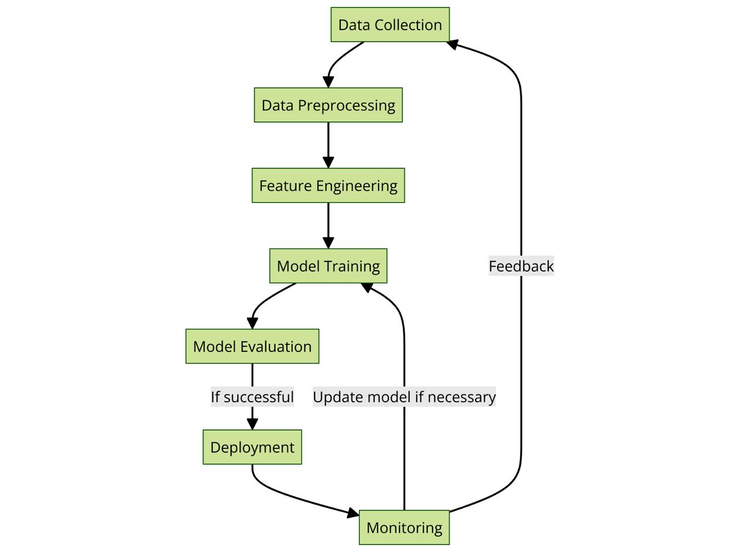
WORKFLOW OF PROPOSED SYSTEM

Slide 16
REFERENCES
Kavianpour, P., Kavianpour, M., Jahani, E. et al. A CNN-BiLSTM model with attention mechanism for earthquake prediction. J Supercomput 79, 19194–19226 (2023). https://doi.org/10.1007/s11227-023-05369-y
Ghimire, S., Guéguen, P. Host-to-target region testing of machine learning models for seismic damage prediction in buildings. Nat Hazards (2024). https://doi.org/10.1007/s11069-023-06394-z
R. Xiong, X. Huang, L. Guo, X. Zou and H. Tian, "Seismic Attribute Extraction and Application Based on the Gabor Wavelet Transform," in IEEE Access, vol. 12, pp. 17807-17822, 2024, doi: 10.1109/ACCESS.2024.3359696. keywords: {Transforms;Feature extraction;Wavelet transforms;Spectral analysis;Manganese;Time-frequency analysis;Data mining;Radio spectrum management;Gabor filters;Support vector machines;Spectrum analysis view;Gabor wavelet transform;LDA;SVM;RF;XGBoost;DRSN},
Mohsen Yousefzadeh, Seyyed Ahmad Hosseini, Mahdi Farnaghi, Spatiotemporally explicit earthquake prediction using deep neural network, Soil Dynamics and Earthquake Engineering, Volume 144, 2021, 106663, ISSN 0267-7261, https://doi.org/10.1016/j.soildyn.2021.106663.

Slide 17
REFERENCES
Puthran, R. . (2023). Spatio-Temporal Analysis of Hybrid CNN-GRU Model for Prediction of Earthquake for Disaster Management. International Journal of Intelligent Systems and Applications in Engineering, 12(3s), 270–281. Retrieved from https://ijisae.org/index.php/IJISAE/article/view/3705
Abraham, A., Rohini, V. (2019). A Particle Swarm Optimization-Backpropagation (PSO-BP) Model for the Prediction of Earthquake in Japan. In: Shetty, N., Patnaik, L., Nagaraj, H., Hamsavath, P., Nalini, N. (eds) Emerging Research in Computing, Information, Communication and Applications. Advances in Intelligent Systems and Computing, vol 882. Springer, Singapore. https://doi.org/10.1007/978-981-13-5953-8_36
R. Li, X. Lu, S. Li, H. Yang, J. Qiu and L. Zhang, "DLEP: A Deep Learning Model for Earthquake Prediction," 2020 International Joint Conference on Neural Networks (IJCNN), Glasgow, UK, 2020, pp. 1-8, doi: 10.1109/IJCNN48605.2020.9207621. keywords: {Earthquakes;Feature extraction;Machine learning;Predictive models;Electric shock;Geology;Convolution;Earthquake prediction;Feature extraction;Explicit feature;Implicit feature;Deep learning method},

Slide 18


